Slide 1


Slide 2












Presented by

Slide 3

Organized By

Slide 4
In Collaboration With

Slide 5


Abdullah Chaudry
DSC LEAD @ ITU

Slide 6

Ahmed Naeem
DSC LEAD @ UCP

Slide 7

Fatima Yousif
DSC LEAD @ MUET Jamshoro

Slide 8

Rao Ubaidullah
DSC LEAD @ SAU

Slide 9

Ali Hassan
DSC LEAD @ QUET

Slide 10

Adil Raza
DSC LEAD @ MUET Khairpur

Slide 12


Hacktoberfest 2020
M Abdullah Ch
Microsoft Learn Student Ambassador
DSC-ITU Lead
MERN Stack

Slide 13
What is GitHub ?
Open Source Repository Hosting Service
Supports collaboration
Best place to store your code
Show case your projects
One of the best community support

Slide 14
Tracking
Git keeps track of your Code , even when you modify it

Slide 15
Understanding the Concept of “Repository”
Works like a container to store your Data Such as Code , Text files
Difference between a Local Repository and Remote Repository

Slide 16
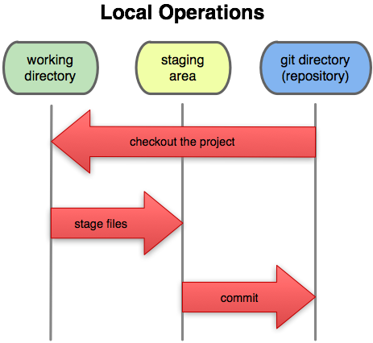
Understanding the term “Staging”
What is “STAGING”
A Gateway to Remote Repository

Slide 17
What is Committing ?
“Commit” stores the changes of your staged file/files in your local repository
To commit the staged files use the following :-
git commit –m “Message”

Slide 18
Download git and setup your account https://git-scm.com/downloads
M Abdullah Ch
M Abdullah Ch

Slide 19
Setting up Your User Name and Email
git config --global user.name “Your Name”
git config --global user.email “Youremail@anything.com”

Slide 20
Basic Git Commands
ls
cd
git init
git remote add origin [gitLink] (remote repo)
git remote -v (remote repo)
git add . (Staging)
git commit -m "First commit“
git push origin master
git log --pretty=oneline

Slide 21
Git Checkout
Takes you back to your desired commit
git checkout hash/branch

Slide 22
Undoing the staged files
git reset HEAD filename
Where HEAD can be your branch name i.e “master”
This “reset” commad resets the staging area to be whatever in the head (the previous committed file)
But this commad do not change the working directory, meaning that the staged file is removed from the staging area , not from the actual file
So, use “git checkout filename” to make our actual file synchronous with our staging area

Slide 23
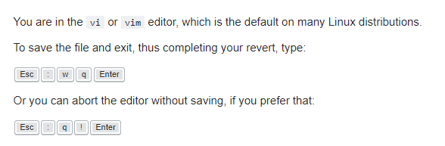
Undoing the committed files
Use “git revert HEAD”

Slide 24
Deleting most recent commits
git reset --hard hash/branch (to the hash, you want to delete)
IT CAN ONLY BE USED FOR RECENT COMMITS

Slide 25
Branching
When various programmers are working on a project, each has its own branch. For example: Feature Branch , GUI Branch , BackEnd Branch
git checkout -b BranchName

Slide 26
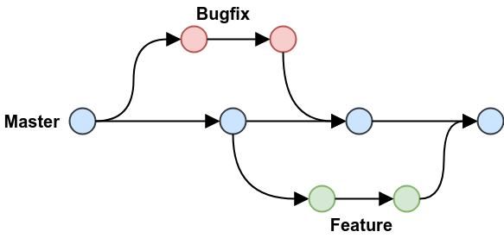
Understanding the concept of Branching
What is a Master Branch ?
When working with somebody, never mess with Master Branch

Slide 27
Graph
git log --pretty=format:'%h %ad | %s%d [%an]' --graph --date=short --all

Slide 28
FINAL DEMONSTRATION
Lets create a pull request to an open source project
FORK THE REPO
https://github.com/OCclassprojects/fixme
git clone url
git checkout –b “branch name”
touch ReadME.md
git add ReadME.md
git commit –m “Your Message”
git push origin “branch name”

Slide 29
Pulling changes locally from The Main Repo
git remote add upstream <original repo link>
git pull upstream master
git push origin (Changes are pushed to the forked repo !)

Slide 30
Perks
Hacktober-fest
Github Student Pack

